Slide 1

Visual interactions in research events
depending on the responses by the participants
depending on the responses by the participants
Janet Salmons, PhD

Slide 2





Slide 3
Typology of Online Visual Methods
Researchers can do the following. . .
Transmit images
View images
Navigate visual environments
Generate images
. . . to achieve these kinds of research purposes
Visual communication
Visual elicitation
Visual collaboration
Use diverse visual approaches to communicate, elicit responses and/or collaborate with participants.

Slide 4
Researchers can do the following. . .
Transmit images
View images
Navigate visual environments
Generate images
Using interactive, mobile technologies
Send pictures, maps, media or links in text message, email or post. Use live webcam.
In web conference or videoconferences. Post in private forums or social media.
Immerse in virtual worlds or games.
Draw or diagram using shared whiteboards or applications.

Slide 5
. . . to achieve these kinds of research purposes
Visual communication
Visual elicitation
Visual collaboration
.
Communicate complex concepts or relationships. Show examples.
Prompt comparisons with participants’ experiences. Catalyze discussion of alternatives.
Annotate existing graphics or images. Create drawings or maps representing participants’ experiences.

Slide 6
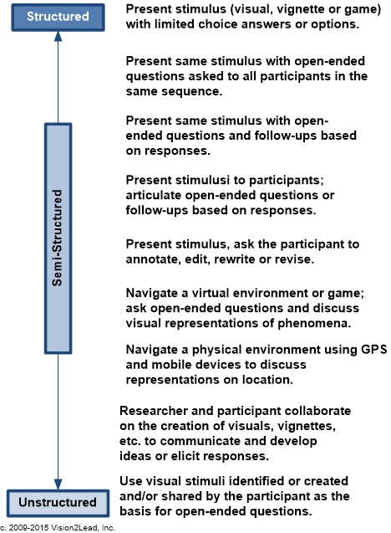
Aligning
StructurE,
Style and
Visual
Research
Approach
Notes:
The same concept described in the previous chapter in the context of interviews can also apply when considering how to use visual stimuli within the research event. To what degree are the visuals consistent across research events with different groups of participants? Did the researcher create the visuals for the purpose of the study and use them in every event? Or am or unstructured exchange where visual collaboration is used each research event will be unique.

